Slide 1
EVENT LEFTOVER REDISTRIBUTION SYSTEM
Notes:
Event Leftover Redistribution System.
Group-4.

Slide 2
1. Industry Background: Social Services
Nature of Industry: Food wastage at events and undernourishment in local communities.
Organization: Community-based NGO focused on food redistribution.
Advancements: The industry is evolving using cloud computing, AI-powered matching algorithms, and automated notification systems to streamline and scale donation processes.
Objectives: Our main goal is to use technology to streamline the donation process, reduce food waste at events, and improve food accessibility for people in need.
Notes:
The social services sector is faced with two critical concerns event food wastage and community hunger.
Our initiative addresses this deficiency by sponsoring a community-based NGO focused on food redistribution.
AI algorithms and real-time notifications are changing the manner in which excess food is matched and distributed efficiently, thanks to the sector.
Our aim is simple: reduce food wastage, accelerate donations, and provide food to the people who need it most.

Slide 3
Organization Background: Local Food Redistribution Initiative
1. Type of Organization: A nonprofit organization focused on sustainable food redistribution and reducing event-related food waste.
2. Strategic Focus: Dedicated to using technology to bridge the gap between event planners and food charities through real-time matching and coordination.
3. Leadership Vision: Committed to becoming a central player in community driven food recovery by deploying AI powered redistribution systems.
4. Commitment to Innovation: Embraces digital transformation through automation, cloud computing, and smart logistics to ensure no food is wasted after events.
Notes:
Our organization is a not-for-profit sustainable food redistribution entity that seeks to reduce event-related food waste and alleviate hunger in the local community.
Technology is the pillar of our strategy to bring event planners and food charities together. With real-time matching and coordination technology, we make donation easier, allowing excess food to flow directly to where it is needed.
Our leadership vision is about long-term effect positioning ourselves as a critical facilitator in food recovery by leveraging the combined strength of AI, cloud technology, and smart logistics.
By our passion for innovation, we're transforming the traditional system of donations. We're building a smarter, speedier, and more scalable system of redistribution to ensure that not a single piece of edible food from events goes to waste.

Slide 4
5. Position in the Industry: Aims to be a community leader in tech-driven food recovery.
6. Emphasis on Patient Experience: Strives to simplify the process for event planners to donate surplus.
7. Emphasis on Patient Experience: Ensures NGOs and shelters get timely, relevant donation alerts.
8. Recognition of Technology's Role: Actively integrating AI, cloud tools, and mobile technology for efficiency.
Notes:
Our business positions itself as a technology driven food recovery pioneer through innovation that will set a new standard of efficiency and reach.
We prioritize strong user experience significantly, enabling how event planners can easily report surplus and how nonprofits will be able to receive real-time alerts tailored to their specifications.
By embracing AI, cloud technologies, and mobiles in a positive way, we gain speed, accuracy, and reach ensuring that each contribution counts and reaches the intended destination, at the right time.

Slide 5
2. Planning Phase
Project Identification:
"As-Is" System:
Surplus food redistribution is handled manually by calls or spreadsheets.
Event organizers have no way to broadcast available leftovers to multiple charities at once.
Charities often miss opportunities due to delayed or lost communication.
No system exists to track donations or ensure timely pickups.
As a result, a significant amount of food goes to waste after events.
Notes:
Today, surplus food redistribution is time-consuming and manual, relying heavily on phone calls or spreadsheets.
Event organizers have no organized system by which to alert multiple charities simultaneously, resulting in inefficient coordination.
Charities lose donations since they arrive late, while organizers sacrifice their sleep in order to make pickups on schedule.
With no platform to track donations or relay automated messages, nutritious food necessarily winds up getting wasted highlighting the urgent need for a superior solution.

Slide 6
Current Problems
Lack of a centralized system to post and manage surplus donations.
Manual coordination leads to slow responses and missed pickups.
No real-time alerts for charities, resulting in food wastage.
Donor and recipient communication is inefficient and untracked.
Limited visibility into inventory and donation history
Notes:
Our system today is beset with serious issues in managing surplus donations.
There isn't a central platform, so it is hard to post, look at, or monitor available excess efficiently.
Manual coordination produces time loss, missed opportunities, and most times, food is wasted.
Without real-time alerts, charities are not notified in time, and pickup windows are often missed.
Donor recipient communication is in disarray and unreported, leaving gaps in terms of accountability.
Lastly, there is no history of donation or inventory transparency, and therefore improvement and data analysis are practically impossible.

Slide 7
Add Values
A. Smart Matching System:
Value-Add:
Matches surplus with recipient needs instantly
Reduces delays and ensures optimal resource allocation
Real-time Notifications:
2. Value-Add:
Enables fast responses via email, SMS, and push alerts
Minimizes spoilage through timely pickups
Inventory Tracking and Reporting:
3. Value-Add:
Keeps accurate records of donations and current stock
Enhances transparency and helps plan future redistribution
Notes:
Our platform has three key value additions that address the problems we've outlined directly.
First, the Smart Matching System automatically matches surplus with the most appropriate recipient in terms of need and proximity. This reduces delays and maximizes the use of donated items.
Second, we utilize real-time notifications SMS, email, and app push notification-based alerts that allow for prompt response and prevent spoilage by enabling timely pickups.
Last but not least, our Inventory Tracking and Reporting feature keeps precise records of donations and inventory. This enhances transparency and helps charities plan more effectively for future redistribution.

Slide 8
Goals
Efficient Redistribution:
Eliminate Food Waste.
Enable timely pickups.
Reduce manual coordination.
Operational Streamlining:
Centralize all surplus posting and tracking in one platform.
Automate donor and recipient communication.
Data-Driven Impact:
Generate real-time reports on donations and pickups
Use AI analytics to improve surplus matching accuracy
Help NGOs forecast food availability and plan resources
Value for communities:
Ensure food reaches shelters and charities on time
Improve transparency and accountability in donations
Support sustainability and social welfare goals
Notes:
The primary goal of our system is efficient redistribution—to cut down food wastage by making timely pickups possible and minimizing manual coordination.
Our goal is to create value for communities by making sure surplus food finds its way to shelters and charities in a consistent manner, while at the same time promoting transparency and accountability in donations.
On the operational side, our system will streamline logistics by aggregating surplus tracking and streamlining donor-recipient communications.
finally, by leveraging data, we can build real-time insights that facilitate better decision-making and allow NGOs to plan well, match better, and forecast needs.

Slide 9
Three Alternatives for New System:
1. Event-Based Communication Platform:
Build a centralized system for posting and managing leftover donations
Auto-notify registered NGOs based on donation type and location
Track pickup confirmations and generate reports
2. AI Powered Matching Engine:
Use AI to match donations to recipient organizations
Prioritize based on urgency, location, and recipient history
Continuously learn from past matches for smarter future allocation
3. Light Weight Mobile App for Donors:
Allow event organizers to quickly report surplus via mobile
Include photo uploads, pickup time windows, and quick match previews
Reduce barriers to entry for occasional donors or smaller events
Notes:
To to meet the needs that we identified, we explored three system options.
The first is an Event-Based Communication Platform which concentrates the management of surplus donations. It informs NGOs by need and location, and it tracks confirmations and reporting in real time.
The second is an AI-Powered Matching Engine that would intelligently match donations with recipients based on learning from history, urgency, and proximity optimal allocation of resources.
And the third is a Lightweight Mobile App to facilitate easy and convenient extra entry for even sporadic donors. With image uploads and pick-up slots, it lowers the participation barrier.

Slide 10
Feasibility Study:
Technical Feasibility:
Assess cloud-based options like AWS for scalability and uptime.
Ensure compatibility with mobile platforms and third-party APIs like Google Maps.
Prioritize data security, notification reliability, and ease of integration.
Economic Feasibility:
Estimate cost of development, deployment, and maintenance.
Project potential cost savings from reduced food waste and improved coordination.
Evaluate return on investment through community impact and long-term efficiency.
Organizational Feasibility:
Analyze how easily event teams and NGOs can adopt the system.
Ensure minimal disruption to current donation workflows.
Foster a culture of tech-enabled sustainability and social good.
Notes:
We conducted a thorough feasibility study to ensure that our proposed system is viable, cost-effective, and adaptable for users.
Technically, we explored scalable cloud platforms like Firebase and AWS with consideration for compatibility with apps like Google Maps and Twilio. We emphasized data security, integration ease, and high reliability.
Economically, we computed development, upkeep, and projected savings by waste elimination and improved logistics. We were concerned with long-term return on investment and benefit to the community.
Organizationally, we considered how smoothly teams and NGOs can transition to leveraging the system with minimal disruption. Our aim is to promote a tech-enabled culture for sustainability and community benefit.

Slide 11
3. Project Selection and Management
Project Objective:
Build a smart donation-matching platform for redistributing event leftovers.
Reduce food waste and improve community support with real-time coordination.
Project Plan: Managing and Controlling
Assign roles: project lead, frontend, backend devs, tester, and NGO coordinator.
Define responsibilities and review progress regularly for smooth execution.
Project Planning
Use WBS(Work Breakdown Structure) to break tasks: UI design, backend logic, notification system, testing.
Define deadlines and milestones for development, testing, and final delivery.
Communication Plan
Use Slack/WhatsApp + email for real-time team sync.
Weekly check-ins, sprint reviews, and feedback collection from NGOs and organizers.
Project Scope and Objectives
Focus on automating food posting, notification, and inventory tracking.
Deliver measurable outcomes in reduced food waste and faster response times.
Notes:
Our project is focused on developing a smart donation-matching platform to efficiently redistribute event leftovers and reduce food wastage.
To achieve this, we assigned specific tasks—ranging from project lead to developers and NGO coordinators—and maintained regular check-ins to monitor progress.
The scope of the project is to automate posting of food, notifications, and inventory management. Our goal is to deliver measurable improvements in speed as well as efficiency.
Planning was made easier through a Work Breakdown Structure, which allowed us to track UI development, backend logic, testing phases, and deadlines.
Communication was made easier through Slack, WhatsApp, and email, complemented by sprint reviews and NGO feedback loops to ensure continuous alignment and clarity.

Slide 12
Monitoring and Control
Monitor progress, manage issues, and control changes.
Ensure delivery quality through regular validations and testing.
Reporting Communication
Provide timely updates and progress reports.
Finalize documentation for milestones and outcomes.
Individual Assignments and Deadlines
Assign responsibilities for development, testing, and presentation.
Track all due dates using WBS and milestone chart.
Project Team Communication Plan
Establish clear channels for updates like Mails, Teams.
Define response times, meeting cadence, and reporting formats.
Project Scope
Develop an automated system for event leftover redistribution.
Integrate AI and cloud tools to optimize donation tracking and matching.
Notes:
During the execution stage, we monitored progress closely, solved any issues, and ensured delivery quality through continuous validation and testing.
We provided transparency through timely reporting and comprehensive documentation of all milestones and outcomes.
Responsibilities for development, testing, and presentation were clearly divided between team members with due dates tracked using WBS and milestone charts.Communication was carried out via email and Microsoft Teams with defined response times and formalized meeting protocols.
The entire project was about creating an AI-based automated donation redistribution system with the help of cloud tools, having effective tracking and matching in real time.

Slide 13
4. Requirements Determination
Requirements Analysis Techniques:
Conduct interviews with event organizers and charity representatives.
Identify pain points in current surplus coordination methods.
Analyze event workflows, donation patterns, and inventory needs.
Use surveys to gather data on notification preferences and response time.
Requirements Gathering Techniques:
Brainstorm features with stakeholders and developers.
Team discussions and scenario modeling.
Developed preliminary wireframes to simulate workflows.
Created use cases for donation posting, matching, and confirmation.
Build use cases to model key interactions.
Notes:
In creating system requirements, we first spoke with event organizers and charity volunteers to gauge prevalent issues of surplus coordination.
We analyzed workflows, donation patterns, and inventory needs, and undertook surveys in order to pick up on preferred notification timing and response.
Concerning methods of gathering, we brainstormed with stakeholders, conducted scenario modeling, and developed wireframes as modes of workflow visualization. Use cases were created for main processes including posting donations, matching them up with recipients, and verifying pickups being the heart of our system design.

Slide 14
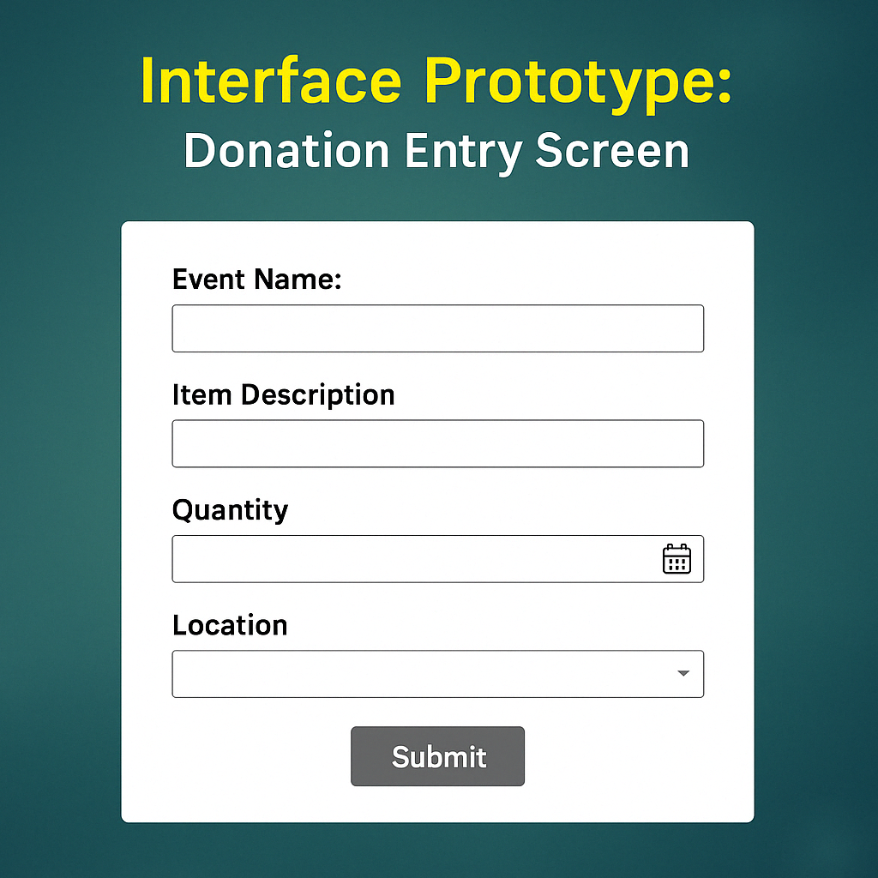
Interface Prototype
Donation Entry Screen:
Purpose:
This screen allows event organizers to quickly log leftover items for donation after an event.
Features:
Easy-to-fill form for item description, quantity, expiry, and location
Streamlined input to reduce time and friction for event staff
Simple, clean design to support rapid donations in real time
Notes:
This page is for event organizers to record surplus food items for donation right after an event.
The page is simple and user-friendly, and users can fill in the most critical information like item description, quantity, expiration, and location in seconds.
We aimed to minimize time and effort for staff while maintaining the integrity of donation information. A minimalist and clean design was selected to facilitate real-time logging with little training or confusion.

Slide 15
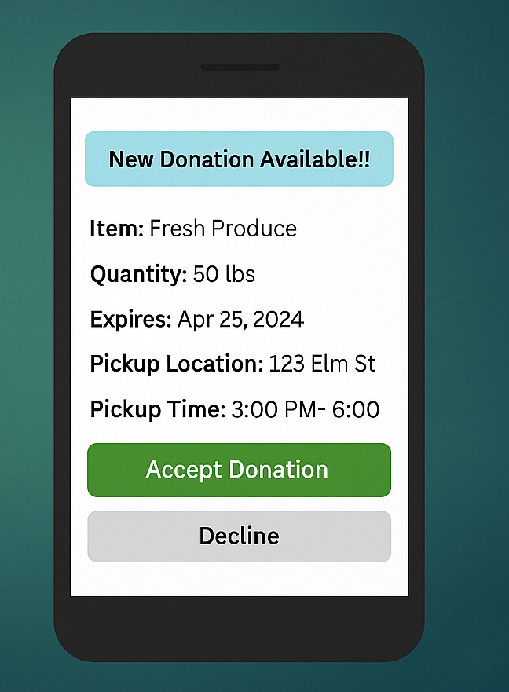
Interface Prototype – Charity View
Donation Visibility:
Purpose:
This screen notifies charity representatives in real-time about nearby available donations.
Features:
View donation details like item, quantity, and pickup location.
Accept or decline the donation with one click.
Optional integration with maps for navigation.
Matters:
Enables fast response and ensures that food gets to those in need quickly.
Reducing delays helps maintain item quality and maximizes community impact.
Notes:
This screen is meant for charity agents to be alerted in real time of in-area donation pickups.
It displays a good vision of important information such as item description, amount, expiration, and pickup location.
The user can accept or decline the donation in real time with one tap, reducing coordination time and increasing response time.
We have also provided optional map integration to make it easier to navigate so that the food will get picked up fresh and still functional.

Slide 16
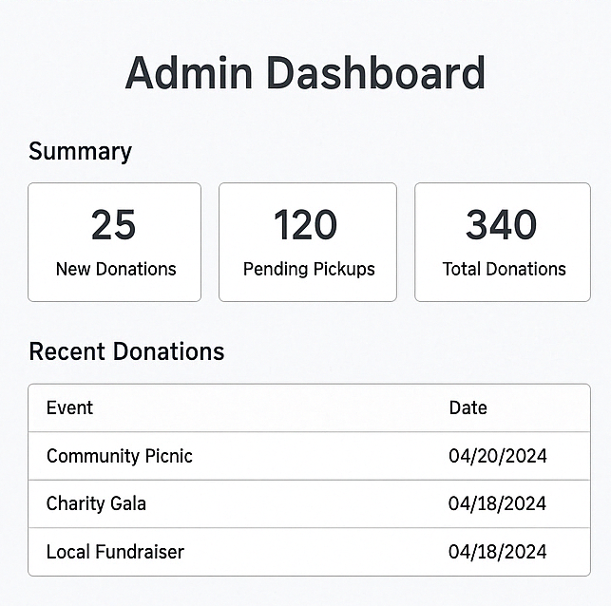
Interface Prototype – Admin Dashboard
Admin Dashboard:
Purpose:
Gives the system admin a centralized view of donation activity and platform performance.
Features:
Real-time data on donations, matches, and pickup status
Visual insights through charts and logs
Helps ensure operational efficiency and transparency
Matters:
Admins can proactively resolve issues, generate reports, and monitor trends all of which ensure system reliability and community impact.
Notes:
The Admin Dashboard is the point of central control for the system.
It provides real-time reports of platform activity new donations, upcoming pickups, and total transactions.
Admins can monitor platform health in graphic format, audit donation history, and proactively respond to any issue.
Such transparency levels keep transparency intact, optimize efficiency, and exert greater leverage over the donation network.

Slide 17
Data Storage Design
Entities and Attributes:
Event Organizer Entity
Charity Representative Entity
Item Entity
Donation Match Entity
Notification Entity
Entity Descriptions:
Event Organizer Entity: Stores organizer name, contact info, and affiliated organization details. Creates donation posts and system notifications.
Charity Representative Entity: Holds information on NGO contacts who receive donation matches. Receives notifications and confirms donation pickup.
Item Entity: Represents individual surplus items including description, quantity, expiry date, and surplus date. Matched in donation processes.
Donation Match Entity: Tracks the matching of items to specific charity representatives with match date and status. Created by system when item and charity are matched.
Notification Entity: Captures alerts sent to recipients with message content, date, and type. Sent by system and received by representatives.
Notes:
This slide presents the data storage schema for our system, describing the key entities and their roles.
The Event Organizer Entity stores organizer contact details and initiates donation postings.
The Charity Representative Entity manages NGO contacts, tracks notification receipts, and confirms pickup confirmations of donations.
The Item Entity holds the surplus item information quantity, expiry, and surplus dates and serves as the basis for donation matching.
The Donation Match Entity associates items with recipients, recording match dates and status automatically.
Finally, the Notification Entity monitors notifications to recipients with message content, time, and status for easy tracking of communications.

Slide 18
ERD Support:
Relationships: Essential for linking organizers, items, matches, and recipients. This enables real-time tracking of surplus and efficient routing of donations.
Foreign Keys: Used to maintain data integrity across entities. ItemID links to Donation Match. RepresentativeID links to both Notification and Donation Match.
Attributes: Each attribute is carefully selected to ensure accurate tracking and reporting of donation activity.
Normalization: All entities are normalized (at least up to 3NF) to Avoid redundancy, Improve query performance, Ensure clarity in entity roles.
Notes:
This slide illustrates how our ERD design supports the system's efficiency and reliability. Relationships between entities like organizers, items, and representatives allow for effective tracking of surplus and proper routing of donations. We have employed foreign keys to maintain data integrity. For instance, ItemID corresponds to the donation match entity, and RepresentativeID to the notification and match records. All the attributes are chosen to facilitate effective data capture from quantities to timestamps. Finally, we’ve ensured proper normalization up to 3NF to avoid data redundancy, speed up queries, and keep entity roles clearly defined.

Slide 19
Implementation Plan
Implementation Plan:
Build the system based on finalized prototype.
Integrate web and mobile platforms for organizers and recipients.
Ensure deployment environment is cloud-hosted.
Data Integration:
Link real-time item entries with inventory and notification modules.
Secure APIs for sending alerts and syncing charity responses.
System Logic:
Use basic AI logic to match donations based on location, type, and urgency.
Improve logic over time based on feedback and analytics.
User Interface Refinement:
Conduct internal usability testing with mock users.
Make UI simple for fast item reporting and quick approval.
Testing and Quality Assurance:
Perform unit tests, integration tests, and simulated workflows
Ensure system handles edge cases like expired items, duplicate alerts.
Communication Strategy:
Setup in-app alerts + optional email/SMS.
Create FAQ and contact support module for common issues.
Monitoring:
Track key metrics like donation time, match success rate.
Gather user feedback post-launch to refine future versions
Rollout:
Pilot launch in select local events.
Monitor, fix bugs, and gradually expand coverage.
Notes:
Our implementation plan focuses on transforming our prototype into a fully functional system. The build will support both web and mobile platforms, with secure cloud-based deployment. For data integration, we’ll link real-time entries to inventory and notification modules using secure APIs. The system logic uses AI to prioritize matches based on urgency, location, and type, and improves over time with feedback. User interface refinement to speed and simplicity will be confirmed with mock usability testing. Quality assurance will consist of thorough unit and integration testing, representative of real-world corner cases. The communication strategy of the app is to send alerts through the app, optionally opted in using SMS or email. There is also included a user support module. Monitoring plan includes donation times and success rates monitored, and iteratively changing user feedback driving iteration. Finally, we will roll out the system in stages, starting with a pilot and growing as we mature the platform.

Slide 20
Maintenance:
Maintenance Schedule:
Regularly apply bug fixes and software updates.
Monitor system performance and gather user feedback for ongoing improvement.
Flexibility:
Ensure scalability to support growing numbers of events and charities.
Reassess system architecture periodically to adapt to new requirements.
Future Issues/Problems:
Ensuring secure data handling and privacy compliance.
Managing regulatory changes for food safety or nonprofit reporting.
Handling integration with new organizations or platforms.
Adapting to feedback on usability and system behavior.
Notes:
After deployment, maintenance is necessary to ensure the system is reliable and operational. As part of our maintenance strategy, we'll offer continuous bug fixing and updates while monitoring system performance and collecting feedback from users for improvements. In terms of flexibility, the system will be built to scale with the growing number of users and events. We'll also review the architecture from time to time to fit future requirements. Lastly, we’ve identified several future challenges from ensuring data security and regulatory compliance to integrating new partners and adapting to feedback. Ongoing maintenance ensures the system not only works today but evolves to meet tomorrow’s needs.

